Slide 1
Defects – Definition & Effects
Defects – Why do they Occur?
Defects – Fish Bone representation
Defects – Cost of fixing
Defects - Reporting Process
Defects - Life Cycle
Defect Management and its Process
Defect Reporting
Defect Naming & Analysis
Defect Report – Components
Defect Tracking System

Slide 2
Test Log
Test Incident Reports
Testing Status & Results
Reporting Test Results

Slide 3

WHAT IS A DEFECT?
A Software Defect/Bug is a condition in a software product which does not meet a software requirement (as stated in the requirement specifications) or end-user expectations
All end user expectations may not be specified but are reasonable
In other words, a defect is an error in coding or logic that breaks and program fails to perform or malfunction or produces incorrect/unexpected results

Slide 4
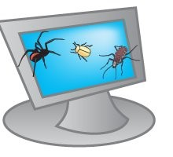
Defects – Why do they Occur
Miscommunication of requirements introduces error in code
Unrealistic time schedule for development
Lack of designing experience
Lack of coding practices experience
Human factors introduces errors in code
Lack of version control
Buggy third-party tools
Last minute changes in the requirement introduce error
Poor Software testing skill

Slide 5
DEFECT LIFE CYCLE
Addresses the status of the defects right from submission to successful closure or cancellation
General Defect Status
New
Open
Assigned
In Progress
Fixed
Re-Open
Reject

Slide 6
DEFECT LIFE CYCLE
New
Deferred
Assigned
Not a bug
Open
Rejected
Fixed
Duplicate
Pending Re-test
Re-Opened
Re-Test
Verified
Closed

Slide 7
DEFECT LIFE CYCLE- Status
The different states of a bug can be summarized as follows:
New
  When the bug is posted for the first time, its state will be “NEW”. This means that the bug is not yet approved.
Open
  After a tester has posted a bug, the lead of the tester approves that the bug is genuine and he changes the state as “OPEN”.
Assign
  Once the lead changes the state as “OPEN”, he assigns the bug to corresponding developer or developer team. The state of the bug now is changed to “ASSIGN”.
Test
  Once the developer fixes the bug, he has to assign the bug to the testing team for next round of testing. Before he releases the software with bug fixed, he changes the state of bug to “TEST”. It specifies that the bug has been fixed and is released to testing team.
Deferred
  The bug, changed to deferred state means the bug is expected to be fixed in next releases. The reasons for changing the bug to this state have many factors. Some of them are priority of the bug may be low, lack of time for the release or the bug may not have major effect on the software.

Slide 8
DEFECT LIFE CYCLE- Status
Rejected
  If the developer feels that the bug is not genuine, he rejects the bug. Then the state of the bug is changed to “REJECTED”.
Duplicate
  If the bug is repeated twice or the two bugs mention the same concept of the bug, then one bug status is changed to “DUPLICATE”.
Verified
  Once the bug is fixed and the status is changed to “TEST”, the tester tests the bug. If the bug is not present in the software, he approves that the bug is fixed and changes the status to “VERIFIED”.
Reopened
  If the bug still exists even after the bug is fixed by the developer, the tester changes the status to “REOPENED”. The bug traverses the life cycle once again.
Closed
  Once the bug is fixed, it is tested by the tester. If the tester feels that the bug no longer exists in the software, he changes the status of the bug to “CLOSED”. This state means that the bug is fixed, tested and approved.

Slide 9
DEFECT ANALYSIS
Severity: How “bad” is it?
  Generally related to the defect’s effect on testing
Defect Severity - Another important aspect of defect tracking is to objectively define your defect severities.
  1-Crash - Set when the defect causes the software to crash
  2-Major Bug - Set when there is a major defect with NO workaround
  3-Workaround - Set when there is a defect but it has a workaround
  4-Trivial - Not a major bug, trivial (e.g. misspelling, etc)
Notes:
9

Slide 10
DEFECT ANALYSIS
Priority: How urgent is it?
  When does this have to be fixed?
Defect Priority - Similar to severity, the priority for resolving the defect should be objective, not subjective.
  1-Fix ASAP - Highest level of priority, must be fixed as soon as possible
  2-Fix Soon - Fix once the priority 1 items are completed
  3-Fix If Time - Fix if time allows, otherwise, fix in a future release
Notes:
10

Slide 11
DEFECT CLASSIFICATION
Defects can be classified in many ways
Can be classified under 4 major categories based on their origin
Requirements Specification
Development Design (High Level Design/Low Level Design)
Coding/Implementation/Programming
Testing

Slide 12
ROOT CAUSE ANALYSIS
A method of problem solving used for identifying the root causes of defects
  Helps in identifying the root cause of a problem
  Determines the relation between root causes of a problem
  Does not include any statistical analysis

Slide 13
REQUIREMENTS RELATED DEFECTS
Requirements can be ambiguous, contradictory, redundant, imprecise
Defects injected in requirements phase are generally very difficult to remove in the subsequent phases
Sometimes, it could be extra functionality provided in the system, which is not required

Slide 14
REQUIREMENTS RELATED DEFECTS
Solution
  Organizations use a formal specification language accompanied by tools to prevent requirements related defects
  Various requirements related documentation are created to prevent defects
Requirements defects
Functional description defects
Interface description defects
Feature interaction defects
Feature defects

Slide 15
DESIGN DEFECTS
Incorrect design of system components, interaction among system components, interaction with external components are termed as “design defects”
Types of design defect
Functional description defects
External interface description details
Module interface description defects
Algorithmic and processing defects
Data defects
Control, logic and sequence defects

Slide 16
CODING DEFECTS
Errors in coding are termed as coding defects
Algorithmic and processing defects
Control, logic and sequence defects
Typographical defects
Initialization defects
Data flow defects
Data related defects
Module interface defects
Code documentation defects
External hardware, software interface defects
Coding defect types

Slide 17
TESTING DEFECTS
Causes of defect
  Improper test cases
  Improper test process
  Improper test plan
  Improper test harness
Types of defects
Test environment related defects
Test case and test procedure defects

Slide 18
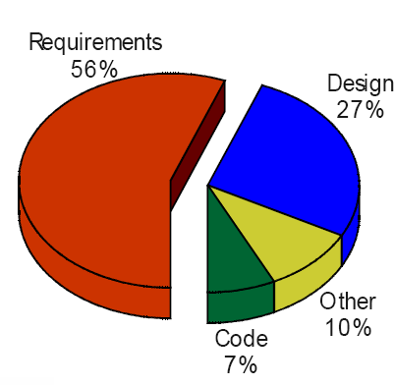
GENERAL STATISTICS: DEFECTS ORIGIN
Recall “Root Cause Analysis”
Requirements 56%
Design 27%
Other 10%
Code 7%

Slide 19
Defects – Fish Bone representation
Fishbone diagram (Cause–and–Effect Diagram - Ishikawa Diagram)
Variations: cause enumeration diagram, process fishbone, time–delay fishbone, CEDAC (cause–and–effect diagram with the addition of cards), desired–result fishbone, reverse fishbone diagram
A graphical representation of inputs (causes) with their associated outputs (effects) used in designing test cases
Aims of Cause-Effect Graphing
Brainstorm session to find out the related causes and effects until we reach the goal
Producing non-redundant, high-yield tests
A
B
Example:
Write
Explain
Ear
Understand
C
Speak
Hear
Reply
C
Mouth
Noise
Enjoy
Dislike

Slide 20
RELATIVE COST OF FIXING
As much as a 20:1 cost savings result from finding errors in the requirements stage versus finding errors in maintenance stage of the software life-cycle
Relative Cost Stage
To Repair
================
0.1 to 0.2 Requirements
-----------------------------
0.5 Design
-----------------------------
1 Coding
-----------------------------
2 Unit Test
-----------------------------
5 Acceptance
-----------------------------
20 Maintenance
-----------------------------

Slide 21
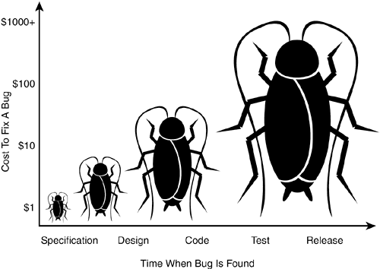
COST OF FIXING DEFECTS
The cost to fix defects/bugs can increase dramatically over time
Notes:
Costs are logarithmic; they increase in size tenfold as the time increases. A bug found and fixed during the early stages – requirements or product spec stage can be fixed by a brief interaction with the concerned and might cost next to nothing.
During coding, a swiftly spotted mistake may take only very less effort to fix. During integration testing, it costs the paperwork of a bug report and a formally documented fix, as well as the delay and expense of a re-test.
During system testing it costs even more time and may delay delivery. Finally, during operations it may cause anything from a nuisance to a system failure, possibly with catastrophic as an aircraft or an emergency service.

Slide 22
PREVENTION OF DEFECTS
Testing early in the life cycle (mainly identifying requirements defects) reduces defects drastically
Fix defects early on
  Cost of fixing the error in subsequent stages is much higher
  The cost of fixing increases exponentially, not linearly

Slide 23
COST OF ERRORS - EXAMPLE
2008 plane crash
  Censor in the flight wrongly showed the altitude as -8 when the flight was very much in the air…
  Another censor which is supposed to read the altitude from first sensor and then start a set of operations when the flight is grounded, resumed ground operations when the flight was in the air as the altitude reading was - 8
  Pilot lost control and the plane crashed

Slide 24
LEGAL CONSEQUENCES OF DEFECTIVE TESTING
Ensure all security procedures are correctly implemented
Ensure protection mechanisms to avoid unauthorized penetration
Test for password cracking, unauthorized entry into software, network security during security testing

Slide 25
DEFECT AND CHANGE TRACKING
Change tracking is the process of tracking all the different kinds of requests to change a product.
Specification Changes
Defect Report
Vendor
Data
Examples
Customer Feedback
Enhancements

Slide 26
LOG CHANGE REQUESTS
Document change requests
Document defects with the following details:
  Project, module, version, tester, type of defect, testing phase
  Priority and severity
  Summary, description, exact steps to reproduce
  Expected result and actual result
  Test environment details
  Attach screenshot (wherever useful)

Slide 27
ASSIGNING PRIORITY TO A DEFECT
P1 – Fix the defect with highest priority i.e. before the next build
  E.g. The login page of an email system fails when valid credentials provided
P2 – Fix the defect with high priority before the next test cycle
  E.g. The system does not allow the user to navigate to emails on subsequent pages
P3 – Fix the defect on moderate priority when time permits before the next release
  E.g. The system does not have option to increase the font size while viewing emails
P4 – Postpone the defect for the next release or live with the defect
  E.g. The system forces the use of mouse for selection in a drop down list box

Slide 28
ASSIGNING SEVERITY TO A DEFECT
S1 (Extreme)
Product crashes or is unusable
S2 (Critical)
Basic functionality is not working
Defect Severity
S3 (Minor)
Product behaves differently
S4 (Cosmetic)
This is GUI related

Slide 29
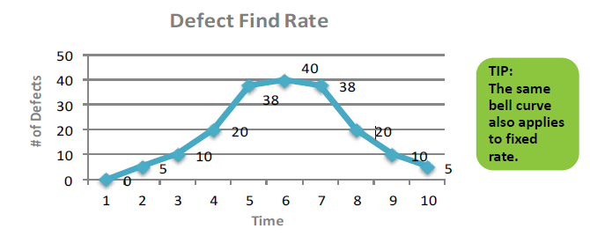
DEFECT FIND RATE AND FIX RATE
Defect find rate
  A measure of tracking and plotting the total number of defects found in the product at regular intervals from beginning to the end of the product development cycle. (Indicates test team’s efficiency)
Defect fix rate
  A measure of tracking and plotting the total number of defects fixed in the product at regular intervals from beginning to the end of the product development cycle. (Indicates development team’s efficiency)

Slide 30
DEFECT METRICS
Outstanding defect rate
  No. of defects yet to be fixed in the project
Priority outstanding rate
  Provides additional focus on those defects that matter for the release
Defect classification trend
  Measures the product from the release perspective and helps in finding the release readiness
    No. of extreme defects
    No. of critical defects
    No. of important defects

Slide 31
DEFECT METRICS
Sample graph of priority wise defects

Slide 32
COMMON DEFECT TRACKING DETAILS
BugZilla – Freely downloadable tool
Test Track Pro
From Sea Pine
IBM Rational Clear Quest
TrackGear
From LogiGear Corporation
PR Tracker
From www.prtracker.com
HP Quality Center
(Defect Module)

Slide 33
DEFECT REMARKS
Condense | Condense it to the size required
Precise | Describe the defect precisely
Accurately | Describes the defect accurately without leaving any ambiguity
Neutralize | Should not aim to annoy any particular individual, be focused on the defect
Isolate | Defect should get isolated from other defects posted so far
Re-Create | It should be possible to reproduce the defect
Impact | Indicate the business impact and impact on the application
Debug | Try to identify the root cause
Evidence | Take screenshots wherever possible

Slide 34
USE CHECKLIST
Use checklist before posting the defect:
  Is the defect reproduced again?
  Checked duplicate defects in the tool?
  Synopsis entered is clear and concise
  Synopsis should contain keywords that you would related with this
  Check appropriate type for the defect
  Have you selected appropriate values for project, module, version, hardware platform, functionality, feature group and area

Slide 35
USE CHECKLIST
Use checklist before posting the defect:
  Assigned appropriate severity and priority?
  Entered expected and actual behavior/result?
  Includes precise steps to reproduce?
  Have included appropriate version of the product
  Included Environment information?
  Screenshots, log files, sample reports
  Ensured there are no typo errors in the defect?

Slide 36
AVOID DUPLICATION
Duplication of defect results in:
  Effort
  Time
  Money
Duplication of defects is a waste of time for not only the testers but also for the developers.

Slide 37
QUIZ QUESTION
Faults found by users are due to:
    Poor quality software
Poor software and poor testing
    Bad luck
Insufficient time for testing
Notes:
Answer:- Poor Quality Software.

Slide 38
QUIZ QUESTION
A deviation from the specified or expected behavior that is visible to all instances of end-users as users is called:
An error
A fault
A failure
A defect
Notes:
Answer:- A Failure.

Slide 39
QUIZ QUESTION
The later in the development life cycle a fault is discovered, the more expensive it is to fix. Why?
The documentation is poor, so it takes longer to find out what the software is doing.
Wages are rising
The fault has been built into more documentation, code, tests, and so on
None of the above
Notes:
Answer:- The Fault has been built into more documentation, code, test and so on

Slide 40
Current Status Reports: Defect Status Report
One is needed for each defect found by testers
Data can be simple or complex, but these are the minimum recommended:
  Defect naming
  Defect Severity
  Defect Type
It is to describe the defect and give the current status of that defect
Notes:
40

Slide 41
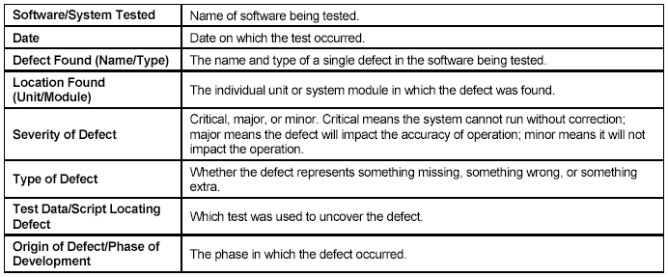
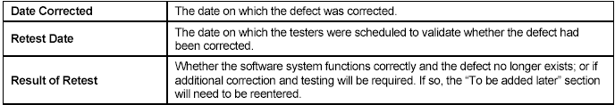
Current Status Reports: Defect Status Report

